Slide 1
CS112 : Introduction to Python Programming
Week 5: lab practice

Slide 2
Practice 1
Searching a value in a dictionary for color-code pairs
color_code = {'red':1, 'green':2, 'blue':3, 'black':4}
Find the code for ‘blue’

Slide 3
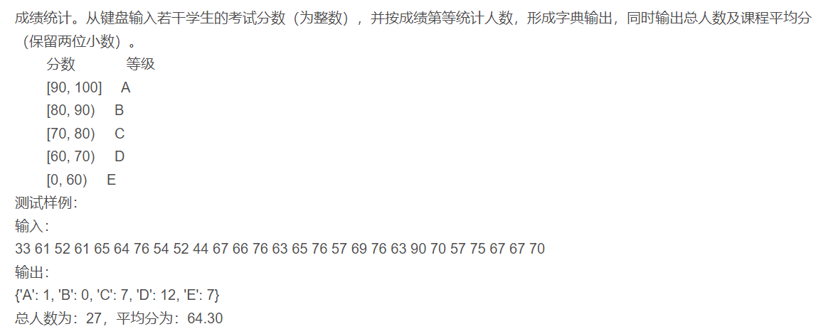
Practice 2

Slide 4
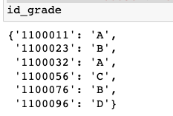
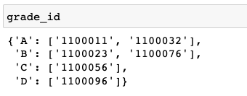
Practice 3
Convert the id:grade dictionary to grade:id dictionary
id_grade = {'1100011': 'A', '1100023': 'B', '1100032': 'A',
'1100056': 'C', '1100076': 'B', '1100096': 'D'}

Slide 5
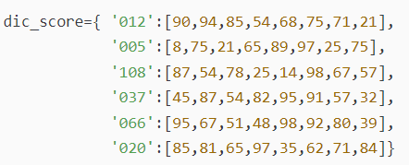
Practice 4
一场校园音乐会比赛，8名评委给6个选手打分如下，请根据评分表，将每个选手去掉一个最高分，去掉一个最低分，取平均分，然后按得分高低排序。

Slide 6
Practice 5
键盘输入一个字符串，输出出现次数最多的字母及其次数。如果多个字母的出现次数一样，则从小到大输出字母及其次数。

Slide 7
Practice 6
从命令行输入5个整数，并放于一个列表，输出！要求：如果输入的不是整数，需要捕获异常，显示请输入整数。输入不足5个整数，需要显示“至少输入5个整数”

Slide 8
Practice 7
Write a program which repeatedly reads integer numbers until the user enters “done”. Once “done” is entered, print out the total, count, and average of the numbers. If the user enters anything other than a number, detect their mistake using try and except and print an error message and skip to the next number.

